Slide 1
Lecturer Claim Management System
Namhla Mkhize (ST10346094) PROG6212 POE PART 3

Slide 2
Introduction:
Overview of the Application: The Lecturer Claim Management System is designed to automate and streamline the process of lecturer claim submissions, approvals, and tracking. It simplifies the workflow by allowing lecturers to submit claims, and managers and HR staff to efficiently review, approve, and track payments.
Purpose of the App: This application aims to replace the manual claim handling system, which often leads to delays, errors, and confusion. By automating the process, it ensures faster and more accurate claim handling.
Target Audience:
HR Departments: For tracking and approving claims.
Managers: For approving or rejecting lecturer claims.
Lecturers: For submitting claims and tracking their status.

Slide 3
Purpose Of Application
Problem Statement:
The Problem: Managing lecturer claims manually is time-consuming, prone to errors, and often results in delayed payments. The existing process lacks transparency and efficiency, leading to frustrations for both lecturers and administrators.
Solution (Your Application):
The Solution: The Lecturer Claim Management System automates the claim submission, approval, and tracking process, enabling lecturers to submit claims easily and track their status, while managers and HR departments can review, approve or reject claims, and generate reports for auditing and analysis.

Slide 4
Key Features
Lecturer Claim Submission:
Lecturers can submit claims through an easy-to-use interface, entering required details like claim type, amount, and supporting documents.
Manager Approval System:
Claims submitted by lecturers are routed to managers for review and approval. Managers can approve or reject claims directly within the system.
Automated Report Generation:
The system automatically generates reports for approved claims, making it easy for HR departments to audit and review claim statistics.
User Roles and Access Control:
The system has defined roles (e.g., Lecturer, Manager, HR) with specific permissions, ensuring that each user can access only the parts of the system relevant to their role.

Slide 5
Application Flow (Process Overview):
Lecturer Submits Claim → Lecturers input claim details (amount, type, date, etc.).
Manager Reviews and Approves/Rejects Claim → Claims are reviewed by managers. They approve or reject based on validation.
HR Department Generates Reports → HR can run reports on approved claims for payment processing and auditing.
Payment Processing → After approval, the claim is processed for payment.

Slide 6
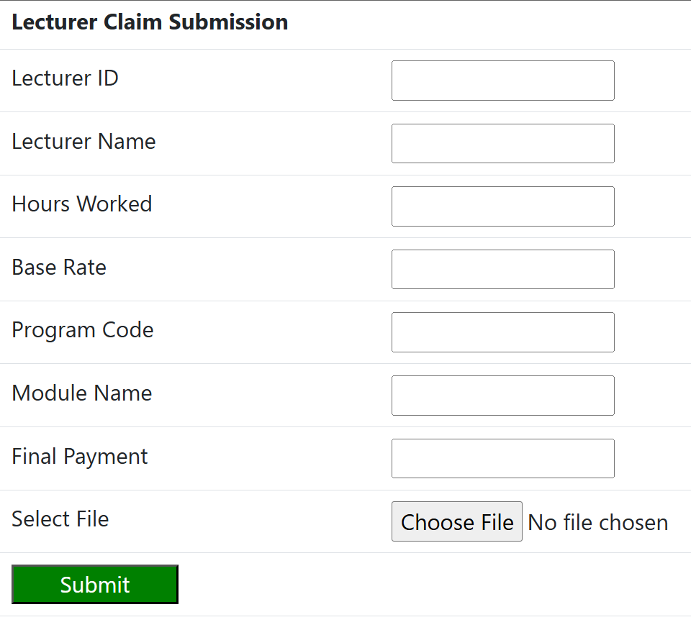
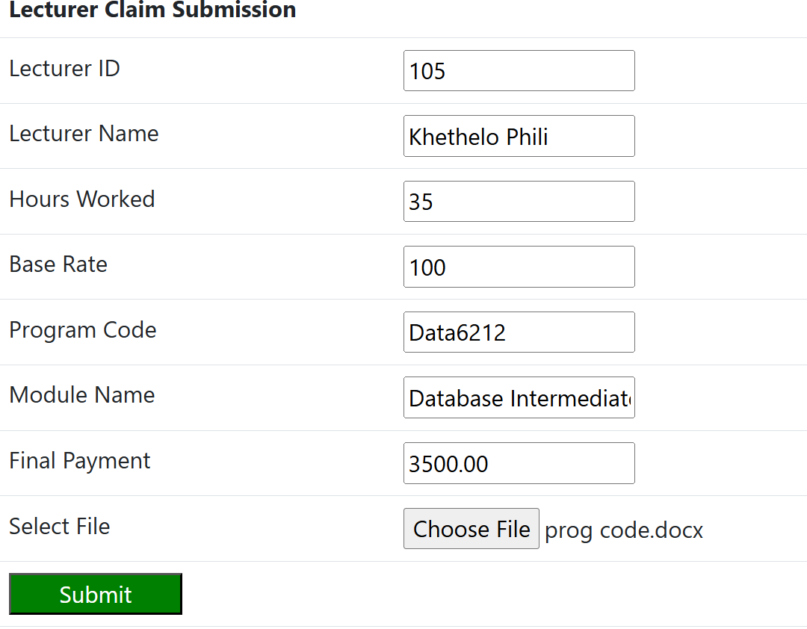
Lecturer Claim Submission Page Demonstration

Slide 7
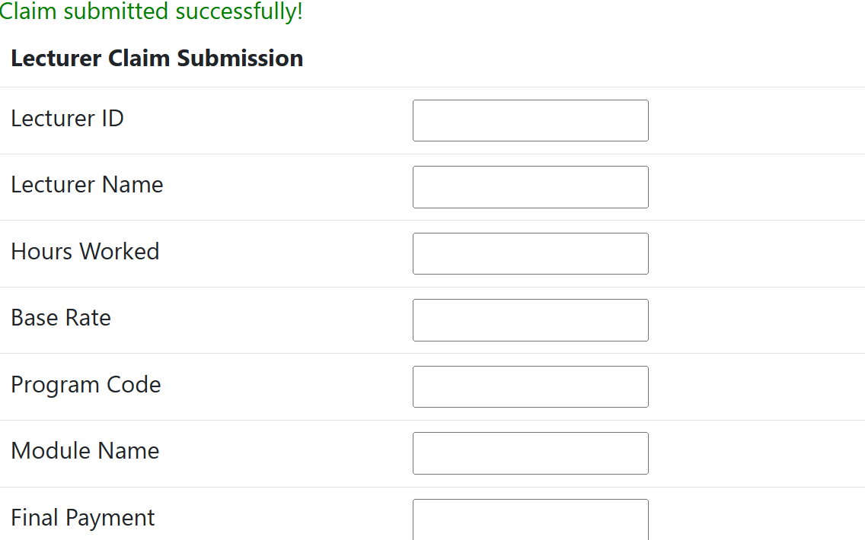
Claim being Submitted

Slide 8
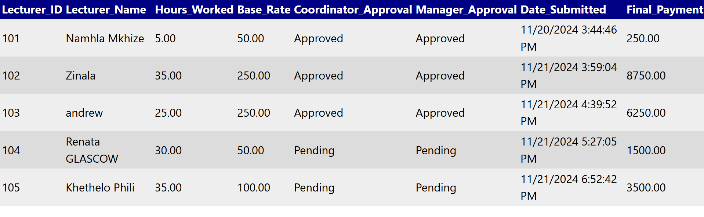
Claim Status Page : Waiting for approval
Example of The claim Status page with approved and pending claims

Slide 9
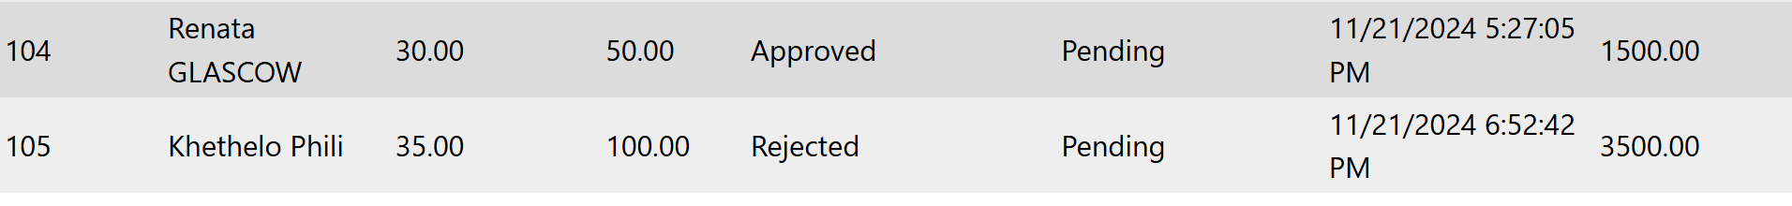
Coordinator Approval
Top is snippet of coordinator Approval Page --- Bottom is how it reflects on the claim status Page

Slide 10
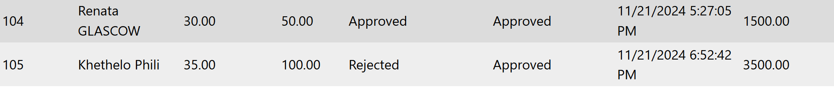
Manager Approval Demonstration
Top is snippet of Manager Approval Page --- Bottom is how it reflects on the claim status Page

Slide 11
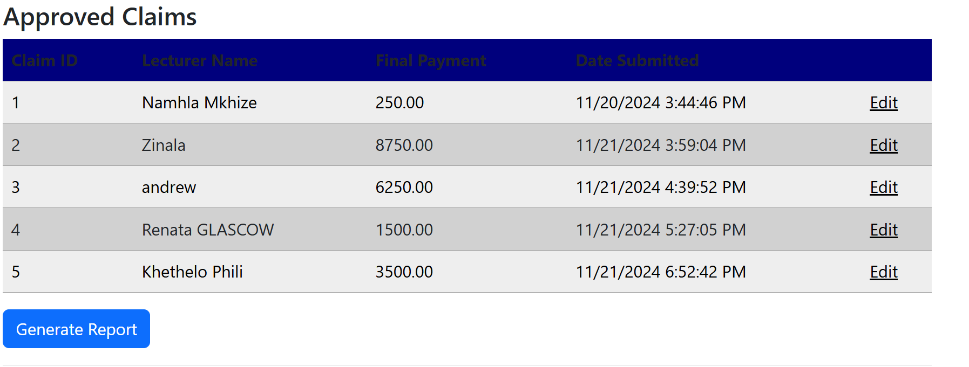
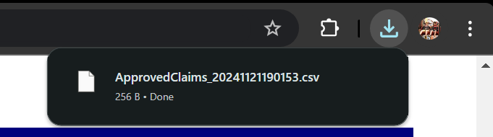
Human Resources Demonstration
Showcase of the HR function As well ability to generate report

Slide 12
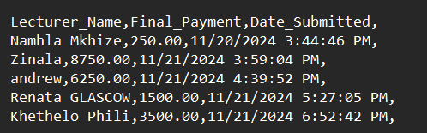
Report Generation
Example of Opened Report generated from the claim management System
And opened in Note Pad

Slide 13
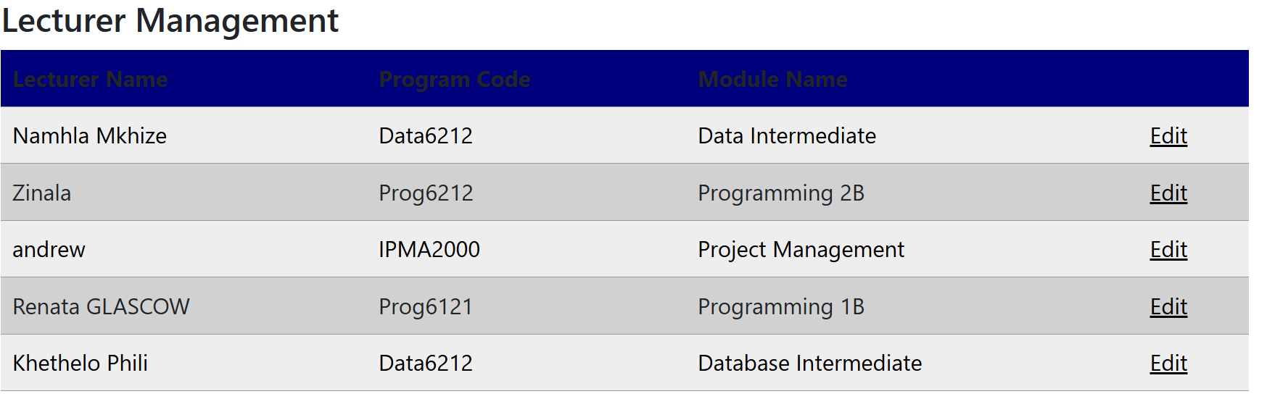
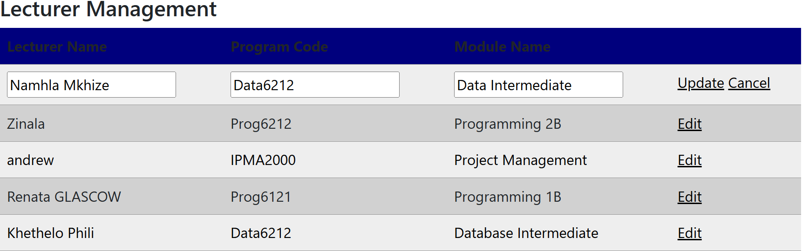
Lecturer Manipulation
Show Case Of Editing form USED BY HR

Slide 14
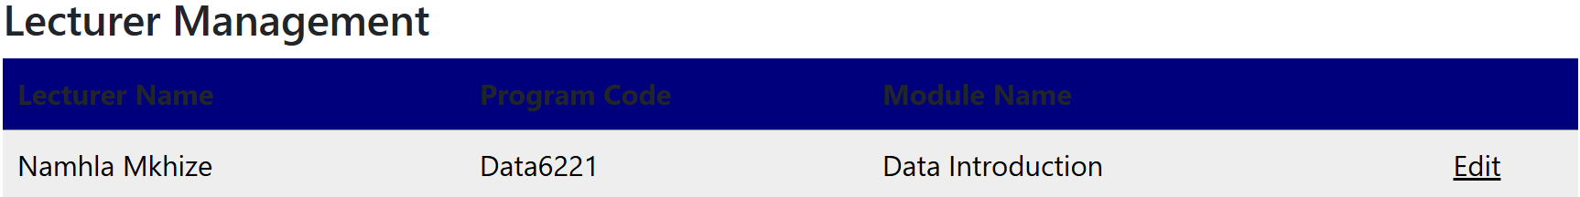
Output
Results From Editing Information :
NB – IF you press the update button it will throw and error but if you go back and press
Cancel the updated details will be prevalent

Slide 15
GitHub commits AND Link

